Slide 1
Towards Reducing the sample complexity of reinforcement learning algorithms using Relational features and Visual information

Slide 2
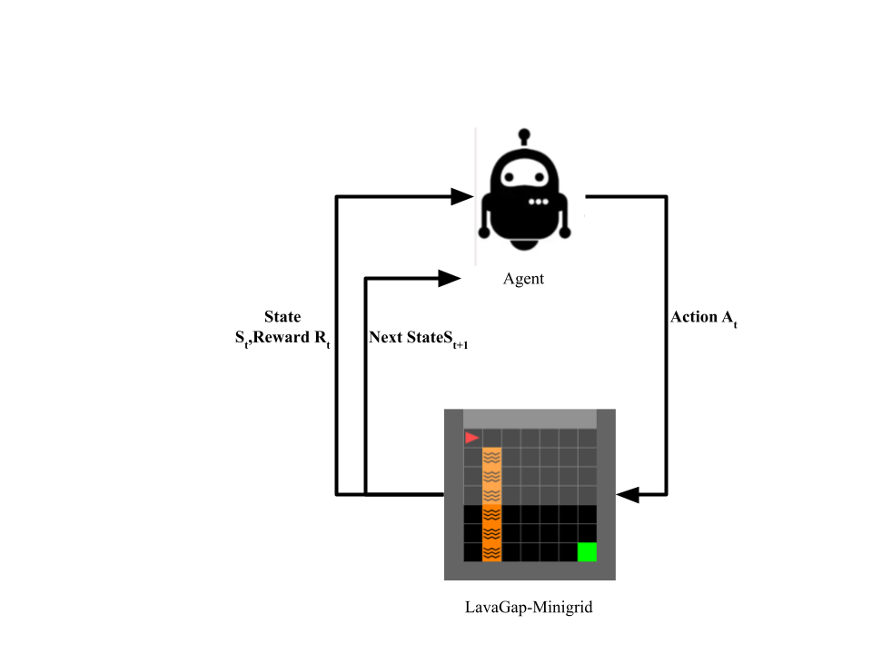
Sample Complexity in Reinforcement Learning
Sample complexity in reinforcement learning (RL) refers to the number of samples (or interactions) that an RL algorithm needs to learn an optimal policy. In other words, it is a measure of how many experiences an agent needs to have in order to learn an optimal policy.
In RL, the agent interacts with an environment to learn a policy that maximizes the cumulative reward. Sample complexity determines how many interactions an agent needs to have with the environment to learn an optimal policy.The fewer interactions it needs, the more sample efficient the algorithm is.
Sample complexity is an important factor to consider when evaluating the performance of RL algorithms because it determines the amount of data and computation required to learn a policy. In some cases, it is also important because it might be difficult or expensive to collect samples.
Reducing the sample complexity of RL algorithms is an active area of research, as it can make RL more practical for real-world applications.

Slide 3

LavaGap-Minigrid
Description : The agent has to reach the green goal square at the opposite corner of the room, and must pass through a narrow gap in a vertical strip of deadly lava. Touching the lava terminate the episode with a zero reward. This environment is useful for studying safety and safe exploration.
Mission Space
Lava: “avoid the lava and get to the green goal square”
otherwise: “find the opening and get to the green goal square”
Action Space :
NUM | NAME | ACTION
0 | LEFT | TURN LEFT
1 | RIGHT | TURN RIGHT
2 | FORWARD | MOVE FORWARD
Trained PPO with Agent View

Slide 4
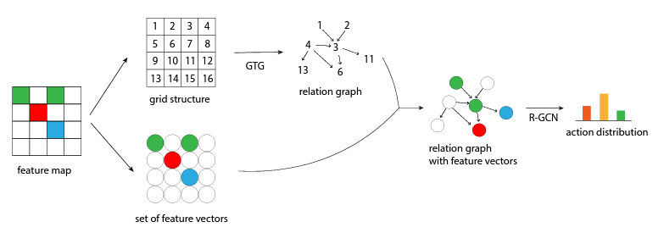
Proposed Approach
Use Continuous Relational information and Visual Features to reduce the training samples for the Reinforcement Learning Agent.
Train using relations with continuous node/edge features and form a GCN like policy to train the algorithm.
From agent view extract relations and encode as a graph and run RL on those graphs.
Jiang, Zhengyao, et al. "Grid-to-graph: flexible spatial relational inductive biases for reinforcement learning." arXiv preprint arXiv:2102.04220 (2021).

